Slide 1
Kimera-Multi: Distributed Multi-Robot Metric-Semantic SLAM
A Comprehensive Technical and Mathematical Summary

Slide 2
1. Introduction & Motivation
Goal: Enable a team of robots to estimate a consistent 3D metric-semantic model of large environments.
Problem: Communication and computation bottlenecks in multi-robot SLAM.
Solution: Kimera-Multi — a fully distributed, real-time, semantically annotated SLAM system.

Slide 3
2. Key Contributions
• Distributed metric-semantic 3D mesh generation.
• Incremental outlier rejection using Pairwise Consistency Maximization (PCM).
• Robust pose graph optimization (PGO) using Riemannian Block Coordinate Descent (RBCD).
• Communication-efficient and scalable.

Slide 4
3. System Architecture
1. Kimera-VIO: Visual-inertial odometry with Bag-of-Words (BoW) for loop detection.
2. Kimera-Semantics: Dense 3D mesh with per-face semantic labels.
3. Distributed Loop Closure Detection: Match keyframes via BoW + geometric verification.
4. Distributed PCM: Robust inlier filtering for loop closures.
5. Distributed PGO: Optimize poses via RBCD.
6. Local Mesh Optimization: Deform mesh using trajectory corrections.

Slide 5
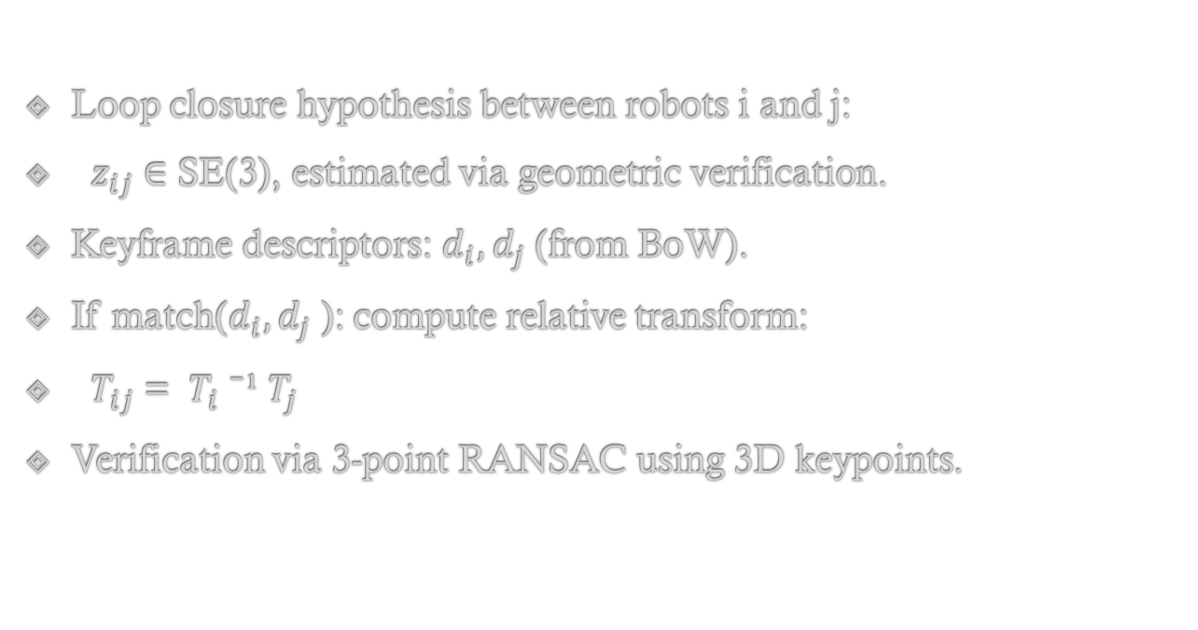
4. Loop Closure Detection: Math Formulation
Loop closure hypothesis between robots i and j:
$z_{ij}$∈ SE(3), estimated via geometric verification.
Keyframe descriptors: $d_{i}, d_{j}$(from BoW).
If match($d_{i}, d_{j}$): compute relative transform:
$T_{ij}$= $T_{i}$⁻¹ $T_{j}$
Verification via 3-point RANSAC using 3D keypoints.

Slide 6
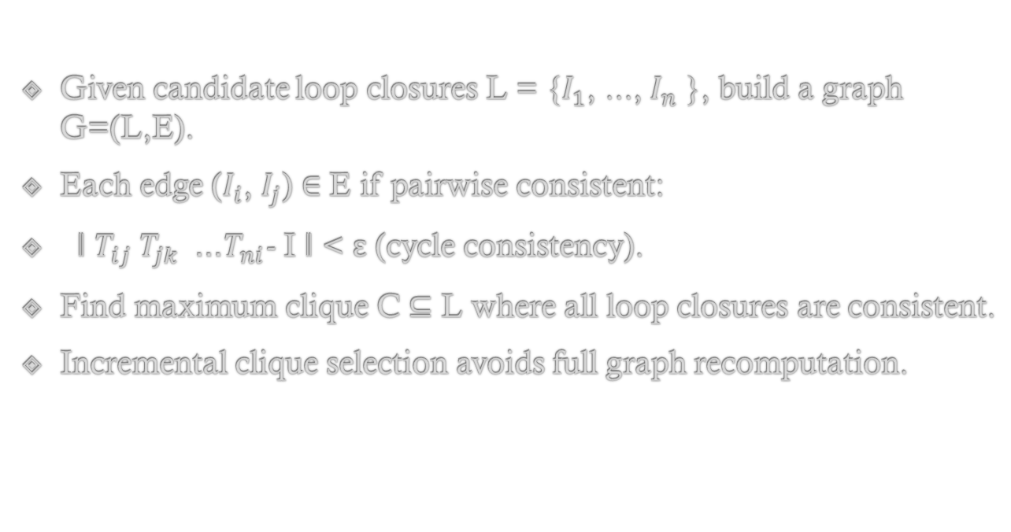
5. Outlier Rejection (PCM): Math
Given candidate loop closures L = {$I_{1}$, ..., $I_{n}⁡$}, build a graph G=(L,E).
Each edge ($I_{i}$, $I_{j}$) ∈ E if pairwise consistent:
‖ $T_{ij} T_{jk}$... $T_{ni}$- I ‖ < ε (cycle consistency).
Find maximum clique C ⊆ L where all loop closures are consistent.
Incremental clique selection avoids full graph recomputation.

Slide 7
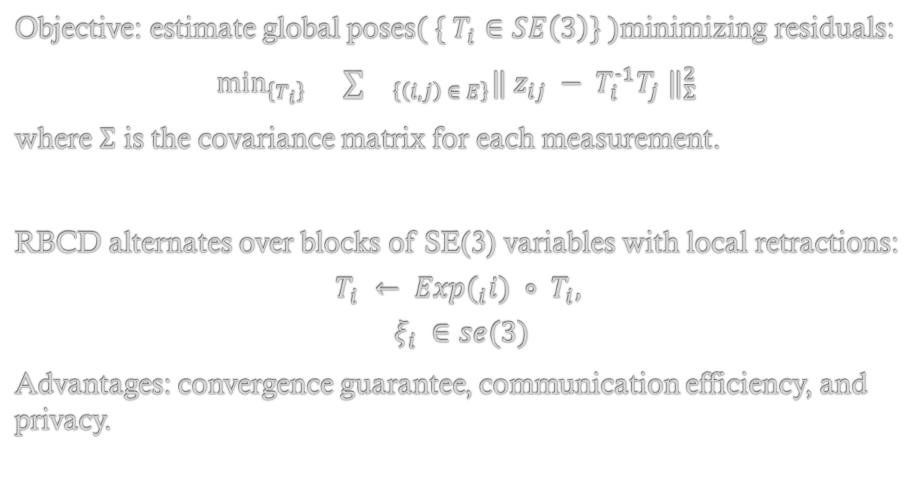
6. Pose Graph Optimization (PGO): Math
Objective: estimate global poses$( \{ T_{i}∈SE\left(3\right)\} )$minimizing residuals:
        $\min_{\left\{T_{i}\right\}}{}∑{}_{\left\{\left(i,j\right) ∈ E\right\}}‖ z_{ij} − T_{i}^{-1}T_{j} ‖_{Σ }^{2}$
where Σ is the covariance matrix for each measurement.
RBCD alternates over blocks of SE(3) variables with local retractions:
$$T_{i} ← Exp(_{i}i) ∘ T_{i},$$
$$ξ_{i} ∈se(3)$$
Advantages: convergence guarantee, communication efficiency, and privacy.

Slide 8
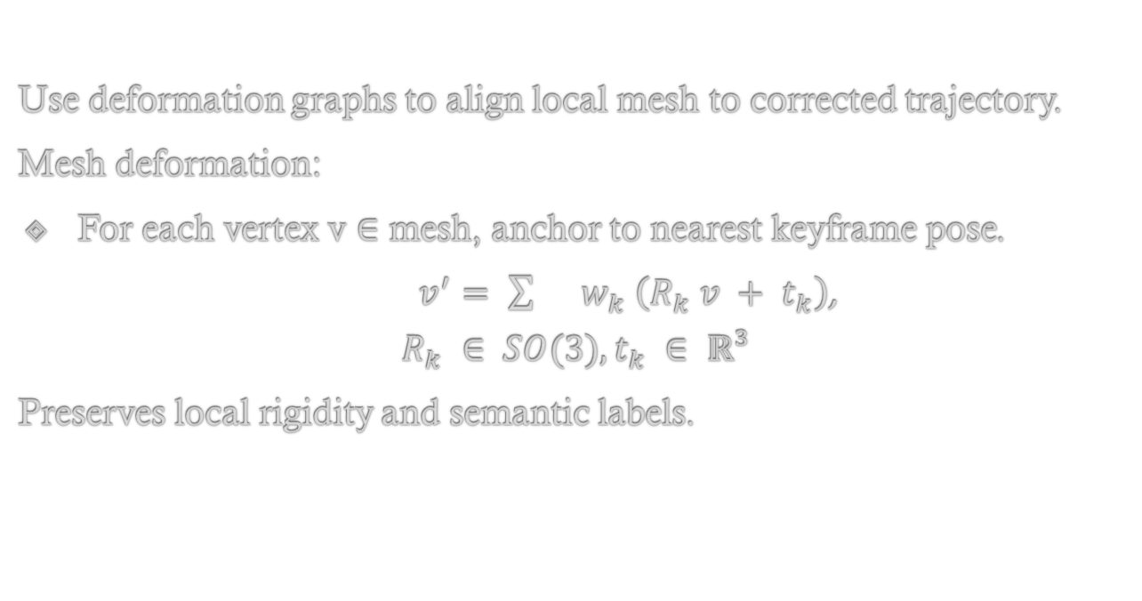
7. Local Mesh Optimization (LMO): Math
Use deformation graphs to align local mesh to corrected trajectory.
Mesh deformation:
For each vertex v ∈ mesh, anchor to nearest keyframe pose.
$v^{′}= \sum{}w_{k} \left(R_{k} v + t_{k}\right)$,
$$R_{k} ∈ SO(3), t_{k} ∈ ℝ³$$
Preserves local rigidity and semantic labels.

Slide 9
8. Experimental Results
Simulation: DCIST Camp and City (Unity), Real: EuRoc dataset.
Outlier Rejection: Incremental PCM achieves ~10x speed-up over batch.
PGO: RBCD achieves lower ATE than DGS and local PGO.
LMO: Improves accuracy of 3D meshes while preserving semantics.

Slide 10
9. Communication & Efficiency
Kimera-Multi uses only 21–38% of bandwidth of centralized systems.
Unicast communication scales quadratically with robot count.
BoW descriptors are compact and support scalable loop detection.
System is modular and implemented in ROS + C++.

Slide 11
10. Conclusion & Future Work
Kimera-Multi combines Kimera's dense semantic mapping with distributed SLAM innovations.
Future work:
• Unify pose optimization and mesh deformation.
• Nesterov acceleration and robust GNC methods.
• Better scalability for large robot teams.

